Slide 1


DESIGN AND DEVELOPMENT OF PUF FOR HARDWARE SECURITY UPDATE
DEPARTMENT OF ELECTRONICS ENGINEERING
MIT CAMPUS, ANNA UNIVERSITY
BATCH : 2022-2026
Guided by:
Dr. V. R. Vijaykumar,
Professor,
Department of Electronics Engineering,
Madras Institute of Technology,
Anna University.
Presented by:
Navabharathi T (2022504526)
Dharshan R (2022504517)
Lakshmanan S (2022504310)

Slide 2
CONTENTS
INTRODUCTION
OBJECTIVE
LITERATURE SURVEY
BLOCK DIAGRAM
WORK PROGRESS
SUMMARY
REFERENCES

Slide 3
INTRODUCTION
A Physically Unclonable Function (PUF) is a hardware-specific security primitive designed to provide cryptographic functionalities such as secure key generation and device authentication, especially for embedded and IoT systems.
The physical structure of a PUF is simple to manufacture but extremely difficult or impossible to replicate, due to uncontrollable variations in the semiconductor fabrication process.While many systems use binary classification (real vs. fake), this approach can be limiting.
A PUF generates a unique output, known as a response, to a given input challenge, based on the intrinsic physical differences present in each Integrated Circuit (IC). These responses are used as digital fingerprints for secure and tamper-resistant identification

Slide 4
OBJECTIVE
To develop a robust Arbiter PUF using Verilog HDL.
To analyze the uniqueness of the Arbiter PUF by generating responses to multiple challenges and comparing the responses across different PUF instances.
To evaluate various PUF metrices such as Inter-chip variation, Intra-chip variation, uniformity, reliability and bit-aliasing.
To implement the developed Arbiter PUF in FPGA platform, focusing on validating its functionality.

Slide 5
LITERATURE SURVEY
S. NO | AUTHOR | TITLE | JOURNAL DETAILS WITH YEAR | SIGNIFICANT CONTRIBUTION
1 | Yao Wang, Guangyang Zhang, Xue Mei, and Chongyan Gu | A High-Reliability, Non-CRP-Discard Arbiter PUF Based on Delay Difference Quantization | IEEE Transactions on Circuits and Systems—I: Regular Papers, Vol. 72, No. 2,, pp. 573–585 February 2025 | Inference : Proposed a delay-difference-based Arbiter PUF (DDQ-APUF) with 99.95% reliability, no CRP discarding, and enhanced ML attack resistance using pseudo-XOR. Problem Identified : Conventional Arbiter PUFs show poor reliability on FPGAs and require CRP filtering or error correction, increasing overhead and security risk.
2 | Bjoern Driemeyer, Holger Mandry, David-Peter Wiens, Joachim Becker, John G. Kauffman, Maurits Ortmanns | An Eye-Opening Arbiter PUF for Fingerprint Generation Using Auto-Error Detection for PVT-Robust Masking and Bit Stabilization Achieving a BER of 2e-8 in 28nm CMOS | IEEE International Solid-State Circuits Conference (ISSCC), Session 17.5 2025, | Inference : Proposed an eye-opening Arbiter PUF combining RO and arbiter benefits with on-chip auto-error detection and masking, achieving ultra-low BER (2e–8) without off-chip data. Problem Identified : PUFs struggle to maintain stability under process, voltage, and temperature (PVT) variations without high overhead or off-chip helper data.

Slide 6
LITERATURE SURVEY
S. NO | AUTHOR | TITLE | JOURNAL DETAILS WITH YEAR | SIGNIFICANT CONTRIBUTION
3 | Sivappriya Manivannan, Rajat Subhra Chakraborty, Indrajit Chakrabarti, and Jothi Ramalingam | “Practical and Efficient PUF-Based Protocol for Authentication and Key Agreement in IoT” | IEEE Embedded Systems Letters, vol. 16, no. 2, pp. 118–121, 2024 | Inference: Proposed a lightweight authentication and key agreement protocol using Arbiter PUF, Fuzzy Extractor, and ECDH. Problem Identified: Conventional systems store large CRP sets or require pairing operations—both unsuitable for IoT.
4 | S. Hemavathy and V. S. Kanchana Bhaaskaran | “Arbiter PUF—A Review of Design, Composition, and Security Aspects ” | IEEE Access, vol. 11, pp. 33979–33993, 2023 | Inference: Provided a comprehensive review of Arbiter PUF designs, metrics, and their resilience against ML attacks. Many existing PUF architectures are still susceptible to deep learning and side-channel modeling.

Slide 7
BLOCK DIAGRAM
Input Challenge (n-bit)
Challenge Register
Switch Network (Controlled by Challenge)
Delay Line Stages
PUF Response
(1-bit)
Arbiter (Timing Comparator)
Signal Race Paths

Slide 8
TYPES OF PUF
PUF maps the input challenge with a unique response, thus creating a challenge-response pair (CRP).
WEAK PUF:
Limited number of Challenge-Response pairs.
Used for cryptographic key generation.
STRONG PUF:
Large number of CRPs.
Used for authentication without using external cryptographic hardware.

Slide 9
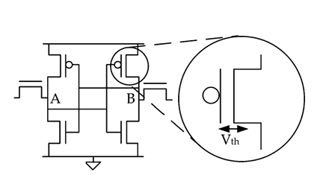
WEAK PUF
SRAM PUF (Memory based PUF)
Power-on state of SRAM cells generates unique Challenge-Response pair.
Other weak PUFs include Butterfly PUF, Ring-Oscillator PUF, etc.

Slide 10
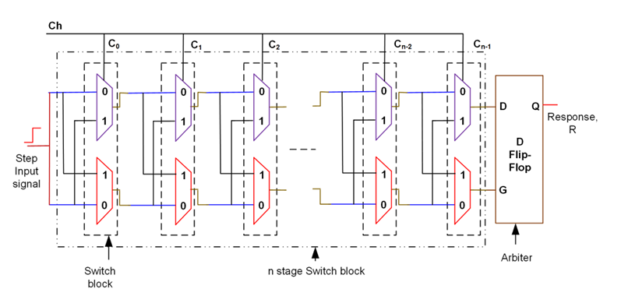
STRONG PUF
Arbiter PUF (Delay based PUF)
Uses manufacturing variability in gate delay as the source of unclonable randomness i.e. a race condition is established in a symmetric circuit.
Other strong PUFs include Optical PUF, Feed-Forward Arbiter PUF, etc.

Slide 11
INTEGRATING UART INTO PUF PROJECT
What is UART?
  Universal Asynchronous Receiver/Transmitter (simple serial communication).
  Uses only TX (Transmit) & RX (Receive) lines.
  Communicates between FPGA and PC via USB.
Why Add UART to PUF?
  Automated Data Collection – Send all PUF responses directly to PC for logging.
  Flexible Challenge Input – Enter challenges from PC without reprogramming FPGA.
  Faster Testing – Quickly gather CRPs from multiple boards.
  Live Demo Capability – Show challenge–response exchange in real time on terminal.
  Large-Scale Evaluation – Easily generate thousands of CRPs for statistical analysis.
Planned Setup:
  PC (Python/Terminal) ⇄ UART ⇄ Basys 3 FPGA (PUF Module)

Slide 12
UART INTEGRATION WITH THE PUF
  Integrated UART Module with PUF design for challenge–response communication.
  Supports receiving challenges from PC via UART RX.
  Generates PUF response for each challenge.
  Sends responses back to PC via UART TX for logging and analysis.
  Verified data flow between PC ↔ FPGA ↔ PUF in simulation.
  Ready for hardware testing with Basys 3 FPGA.

Slide 13
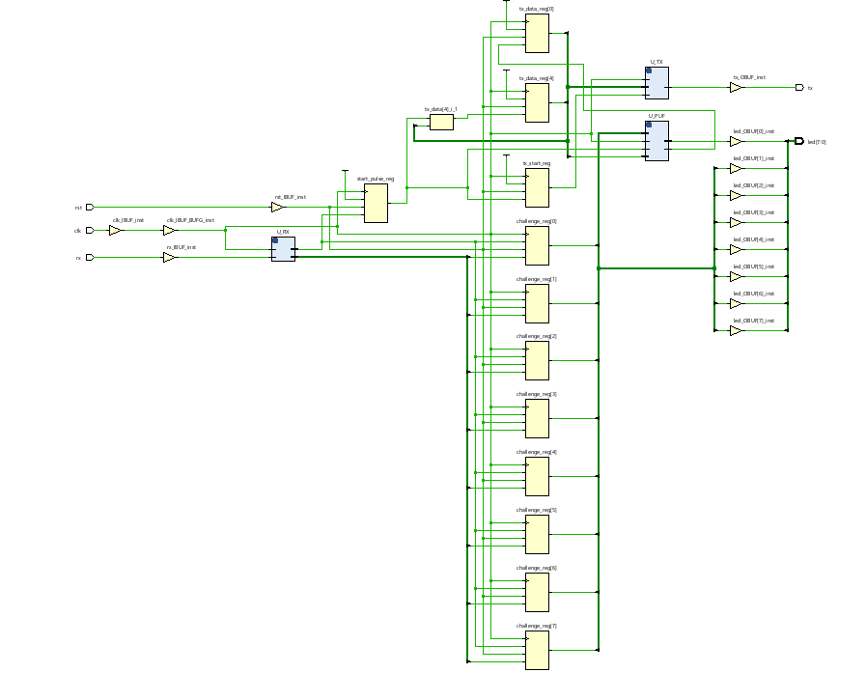
SCHEMATIC OF PUF WITH UART

Slide 14
PUF METRICS
Binary | Response | Response | Response | Response | Response
00000000 | 0 | 1 | 1 | 1 | 1
00000001 | 0 | 0 | 0 | 0 | 0
00000010 | 0 | 0 | 0 | 0 | 0
00000011 | 0 | 0 | 0 | 0 | 0
00000100 | 0 | 0 | 0 | 0 | 0
00000101 | 0 | 0 | 0 | 0 | 0
00000110 | 0 | 0 | 0 | 0 | 0
00000111 | 0 | 0 | 0 | 0 | 0
00001000 | 0 | 0 | 0 | 0 | 0
00001001 | 0 | 0 | 0 | 0 | 0
00001010 | 0 | 0 | 0 | 0 | 0
00001011 | 0 | 0 | 0 | 0 | 0
00001100 | 0 | 0 | 0 | 0 | 0
00001101 | 0 | 0 | 0 | 0 | 0
00001110 | 0 | 0 | 0 | 0 | 0
00001111 | 0 | 0 | 0 | 0 | 0

Slide 15
PUF METRICS
Total entries N = 256
Number of 1s N1 = 84
Number of 0s N0 = 172
Now, the percentage of each:
Percentage of 1s = (N1 / N) × 100 = (84 / 256) × 100 ≈ 32.81%
Percentage of 0s = (N0 / N) × 100 = (172 / 256) × 100 ≈ 67.19%
Answer:
1s = 32.81%
0s = 67.19%
This confirms that the output is biased toward 0s.
Ideal PUF randomness: The responses should be randomly distributed, ideally 50% 1s and 50% 0s.

Slide 16
PUF METRICS
FPGA responses: 255 out of 256 match the reference
Stability Formula:
Stability (%) = (Number of matching responses / Total responses) × 100
Step-by-Step Calculation:
Stability (%) = 255 / 256 × 100
255 ÷ 256 = 0.99609375
0.99609375 × 100 ≈ 99.61%
Result:
Stability = 99.61%
Interpretation:
The PUF is extremely stable
Only 1 response out of 256 flips

Slide 17

Experimental Modifications
Explored Virtual Input/Output (VIO):
Purpose: Replace UART for direct hardware-level interaction and faster on-board testing.
Outcome: Enabled on-board challenge/response visualization and reduced dependency on PC serial communication.
Maintained UART integration for external logging and verification during previous tests.
Note: We did not increase the number of challenge inputs — experiments focused on interface/method changes only.

Slide 18
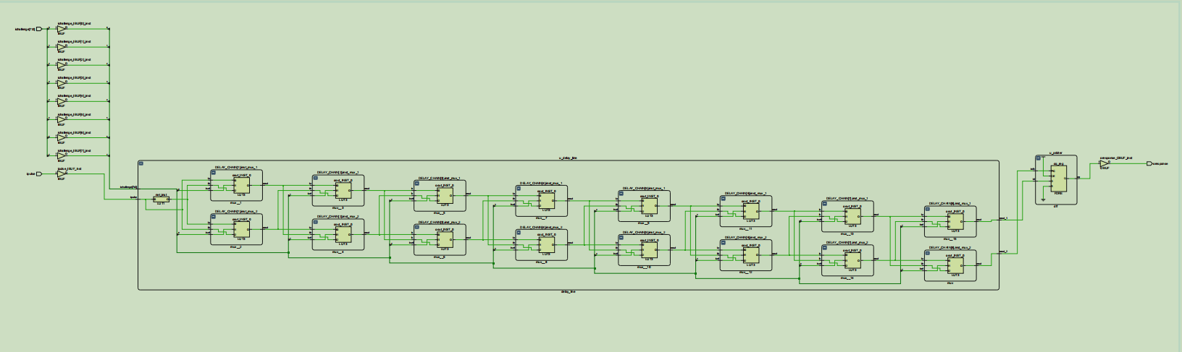
SCHEMATIC DIAGRAM OF PUF WITH VIO

Slide 19
Results and Analysis
Stability: Maintained 87.5% response repeatability, showing minimal bit flips across trials.
Uniqueness: Efforts to increase inter-chip variation through VIO and interface modifications resulted in a uniqueness of only 12.5%.
Reason: Vivado’s automatic placement and routing tends to produce similar delay paths, limiting inter-device variation.
Conclusion: Achieved high reliability; uniqueness remains constrained by FPGA-level optimization.

Slide 20
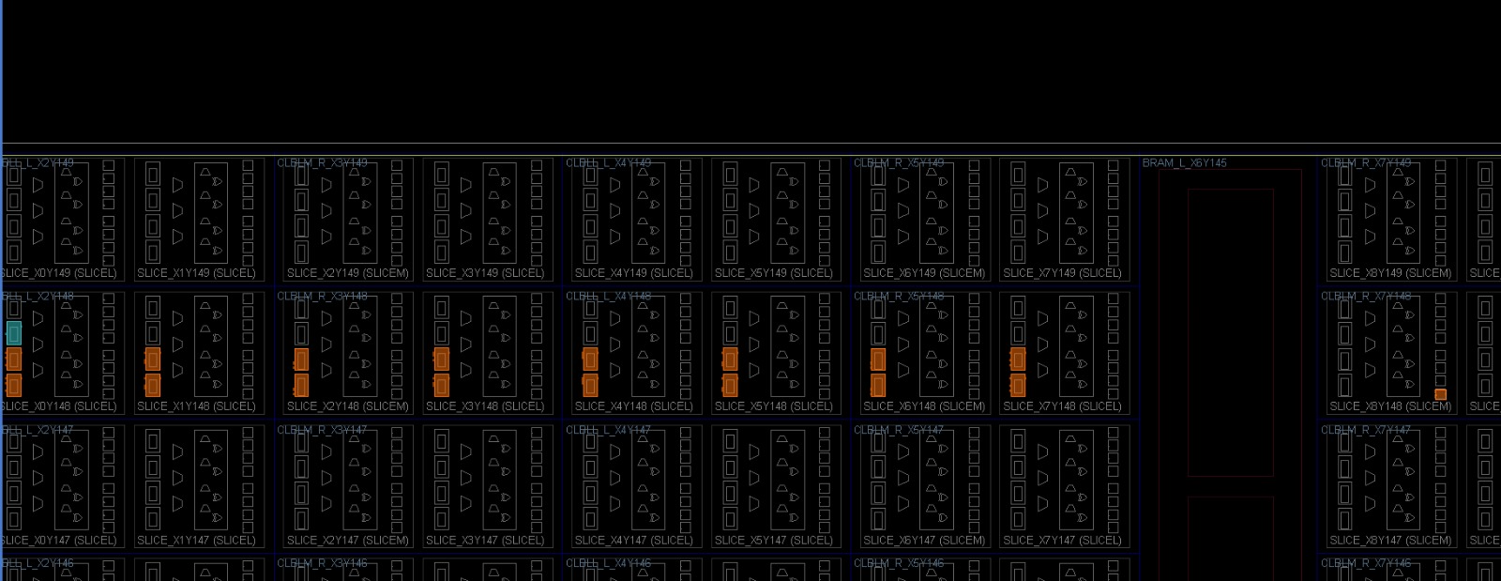
Results and Analysis
Placement of LUTs

Slide 21
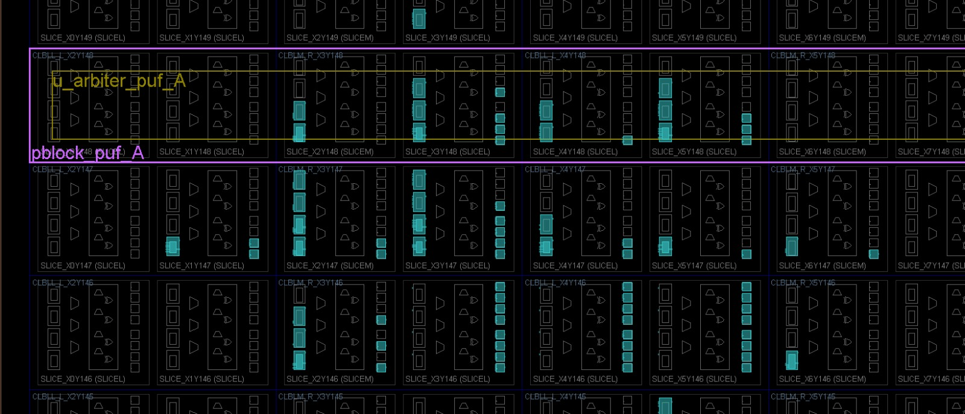
Results and Analysis
Creating Pblock, but LUTs Assigned Outside It

Slide 22
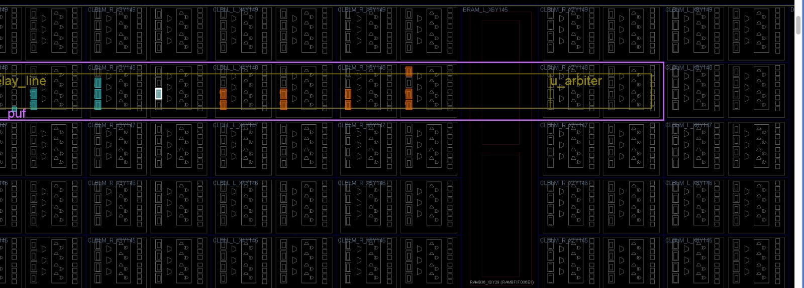
Results and Analysis
Complete Pblock with LUTs Placed Inside

Slide 23
STATUS
Stability:Achieved 98.8% response repeatability using UART-based manual verification, ensuring reliable and consistent responses.
Uniqueness:Recorded 35.44% inter-chip uniqueness using UART-basedtesting.
Reason: Vivado’s automatic placement and routing still cause similar delay paths across FPGAs.
Conclusion:Maintained high stability (98.8%) with improved uniqueness (35.44%) using UART-based manual testing; uniqueness remains limited by FPGA routing optimization.

Slide 24
FPGA IMPLEMENTATION RESULTS
The performance of the PUF was evaluated based on industry-standard metrics.
Stability: The design achieved 98.8% stability, demonstrating high reliability and consistency of the response bits across varying environmental conditions.
Uniqueness: The inter-chip Hamming distance analysis yielded a uniqueness score of 16.47%(for 8bit), which is below the ideal value of 50%, indicating weak device-specific differentiation.

Slide 25
FPGA Implementation Flow & Validation
The design was implemented on an FPGA using the Xilinx Vivado Design Suite, following a standard RTL-to-bitstream methodology.
The flow consisted of RTL design, followed by logic synthesis, and finally place and route (P&R) to generate the device-specific bitstream.
Timing closure was successfully achieved by analyzing and meeting setup and hold time requirements, indicated by a positive Worst Negative Slack (WNS) and zero Total Negative Slack (TNS). Resource utilization was monitored to ensure design efficiency.
Functional validation was conducted on the hardware through manual testing, using a UART interface to send challenges and receive responses from the PUF.

Slide 26
ASIC IMPLEMENTATION FLOW
SYNTHESIS:
The RTL code was synthesized for an ASIC using Cadence Genus.
The synthesis produced a gate-level netlist and an SDC file describing the timing requirements.
The design targets the SCL 180 nm technology and includes I/O pad cells from the SCL PDK.
The final netlist is now ready for physical design steps such as floorplanning, power planning, and PNR.

Slide 27
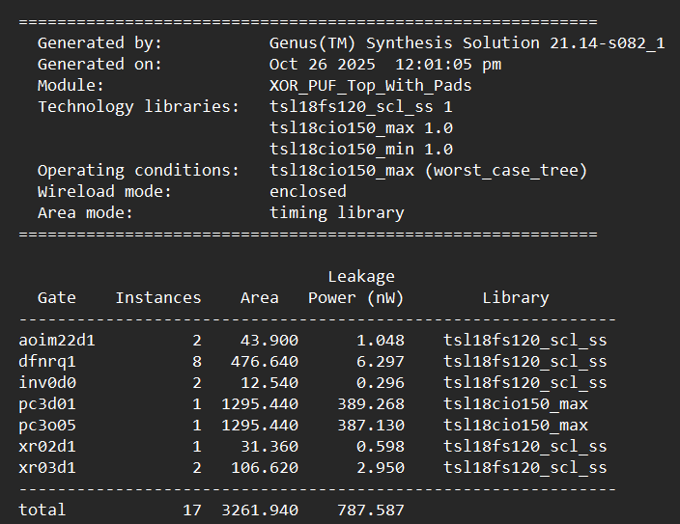
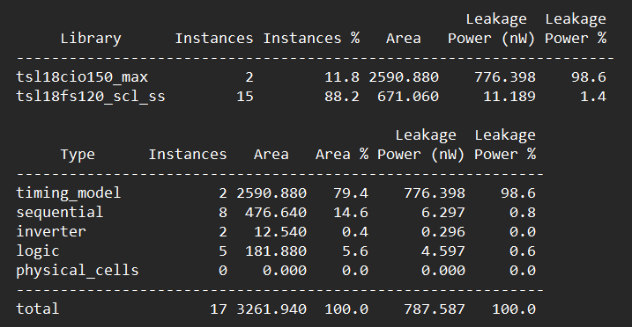
ASIC POST-SYNTHESIS ANALYSIS
Cell & Path Report (syn_opt_gates.rpt): Provides a breakdown of standard cell counts, overall logic depth, and a detailed analysis of the critical timing paths in the design.

Slide 28
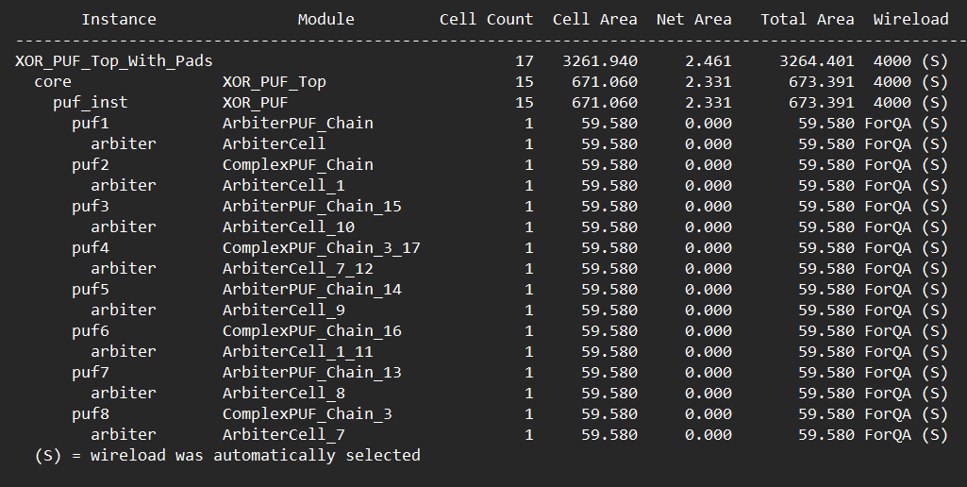
ASIC POST-SYNTHESIS ANALYSIS
Area Report (area.rpt): Confirms the total combinational and non-combinational cell area, with a hierarchical breakdown for each module.

Slide 29
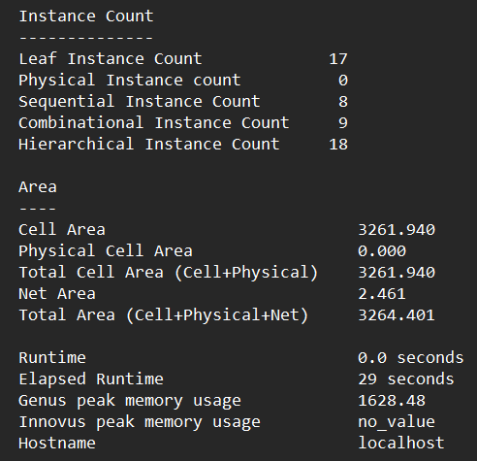
ASIC POST-SYNTHESIS ANALYSIS
Quality of Result Report (qor.rpt): Indicates a clean synthesis run with no unconstrained paths, acceptable WNS/TNS, and no violations for maximum transition or maximum fanout design rules.

Slide 30
Apply manual floorplanning or routing constraints in Vivado to try to preserve physical delay differences.
Explore alternative PUF architectures (e.g., XOR Arbiter PUF, RO-PUF) or different FPGA families for improved uniqueness.
Perform environmental testing (temperature/voltage) to further evaluate robustness.
Prepare hardware demo and metric comparison table for the next review.
SUMMARY
8-Bit PUF Analysis
Metric | Value | Calculation / Comment
Total Challenges / Bits | 255 | Based on an 8-bit challenge space (2⁸−1)
Ones in Response FPGA 1 | 118 (46.27%) | Nearly balanced, indicating good randomness
Ones in Response FPGA 2 | 114 (44.71%) | Nearly balanced, indicating good randomness
Flipped Bits (Inter-Chip HD) | 42 | The number of bits that differ between two FPGAs
Uniqueness | 16.47% | (42/255)×100 Low result (ideal ≈ 50%)
Stability | 98.8% | High reliability, suitable for security applications

Slide 31
SUMMARY
16 bit PUF Response
Challenge | Response-1 | Response-1 | Response-2 | Response-2
0 | 0 | 0 | 0 | 0
1 | 0 | 0 | 0 | 0
2 | 0 | 0 | 0 | 0
3 | 0 | 0 | 0 | 0
4 | 0 | 0 | 0 | 0
5 | 0 | 0 | 0 | 0
6 | 1 | 1 | 0 | 0
7 | 1 | 1 | 1 | 1
8 | 1 | 1 | 1 | 1
9 | 1 | 1 | 0 | 0
10 | 1 | 1 | 1 | 1
11 | 1 | 1 | 1 | 1
12 | 1 | 1 | 1 | 1
13 | 0 | 0 | 1 | 1
14 | 0 | 0 | 0 | 0
15 | 0 | 0 | 0 | 0

Slide 32
Apply manual floorplanning or routing constraints in Vivado to try to preserve physical delay differences.
Explore alternative PUF architectures (e.g., XOR Arbiter PUF, RO-PUF) or different FPGA families for improved uniqueness.
Perform environmental testing (temperature/voltage) to further evaluate robustness.
Prepare hardware demo and metric comparison table for the next review.
SUMMARY
16-Bit PUF Analysis
Metric | Value | Calculation / Comment
Total Challenges / Bits | 65,536 | Based on a 16-bit challenge space (2¹⁶)
Ones in Response FPGA 1 | 32,437 (49.50%) | Excellent balance, close to the ideal 50%
Ones in Response FPGA 2 | 32,628 (49.79%) | Excellent balance, close to the ideal 50%
Flipped Bits (Inter-Chip HD) | 23,225 | The number of bits differing between FPGA 1 and FPGA 2
Uniqueness | 35.44% | Strong result, approaching the ideal 50%
Stability | 98.8% | High reliability, suitable for security applications

Slide 33
REFERENCES
J.Plusquellic and M.Areno,“Correlation-based robust authentication(cobra) using helper data only,” Cryptography, vol. 2, no. 3, 2018, Art. no. 21. [Online]. Available: https://www.mdpi.com/2410--387X/2/3/21
D.Heeger and J. Plusquellic, “Analysis of IoT authentication over LoRa,” in Proc. IEEE 16th Int. Conf. Distrib. Comput. Sensor Syst., 2020, pp. 458–465.
J.Plusquellic, “Shift register, reconvergent-fanout (SiRF) PUF implementation on an FPGA,” Cryptography, vol. 6, no. 4, 2022, Art. no. 59. [Online]. Available: https://www.mdpi.com/2410--387X/6/4/59
U. Rührmair et al., “PUF modeling attacks on simulated and silicon data,” IEEE Trans. Inf. Forensics Security, vol. 8, no. 11, pp. 1876–1891, Nov. 2013.
G. T. Becker, “On the pitfalls of using Arbiter-PUFs as building blocks,” IEEE Trans. Comput.-Aided Design Integer. Circuits Syst., vol. 34, no. 8, pp. 1295–1307, Aug. 2015.

Slide 34
REFERENCES(Cntd.)
Y. Wen and Y. Lao, “Enhancing PUF reliability by machine learning,” in Proc. IEEE Int. Symp. Circuits Syst., 2017, pp. 1–4.
H.Awano, T.Iizuka and M.Ikeda “PUF Net :A deep neural network based modeling attack for physically unclonable function,” in Proc. IEEE Int. Symp. Circuits Syst., 2019, pp. 1–4.
Y. Xu, Y. Lao, W. Liu, Z. Zhang, X. You, and C. Zhang, “Mathematical modeling analysis of strong physical unclonable functions,” IEEE Trans. Comput.-Aided Design Integer. Circuits Syst., vol. 39, no. 12, pp. 4426–4438, Dec. 2020.
J. Delvaux, “Machine-learning attacks on PolyPUFs, OB-PUFs, RPUFs, LHS-PUFs and PUF-FSMs,”IEEETrans.Inf.Forensics Security, vol. 14, no. 8, pp. 2043–2058, Aug. 2019.
Y. Lao and K. K. Parhi, “Statistical analysis of MUX-based physical unclonablefunctions,”IEEETrans.Comput.-AidedDesignIntegr.Circuits Syst., vol. 33, no. 5, pp. 649–662, May 2014.

Slide 35
THANK YOU

